Slide 1
DASH
Adaptation of SNAKE
By Bradley Baker

Slide 2
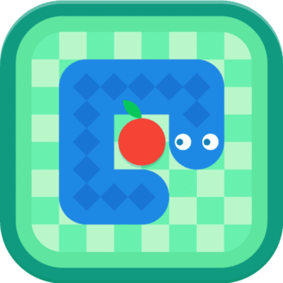
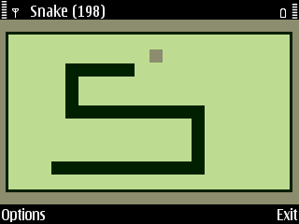
TASK
INTRODUCTION
I was tasked by CTU Training Solutions to create a game that was an adaptation of the game SNAKE, and add my own unique twists.

Slide 3

PROGRAMMING OF DASH
How did I program Dash?
Python
What is Python?
Python is a high level language withing programming.
No 1’s and 0’s
Why Python?
Python is the only programming language I know as of yet.
Python allows the developer to use many feature such as Pygame or turtle to create the game.

Slide 4

What features from Python?
Pygame
What is Pygame?
Pygame is a imported feature within Python that allows a developer to code video games
Why Pygame?
Pygame has an already built-in template
Although there is no GUI there are Pygame event to interact with the game
Easy to learn and understand

Slide 5
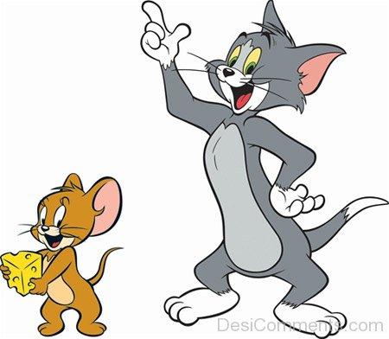
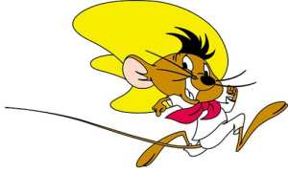
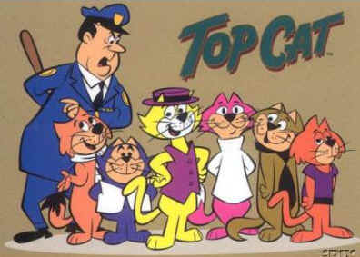
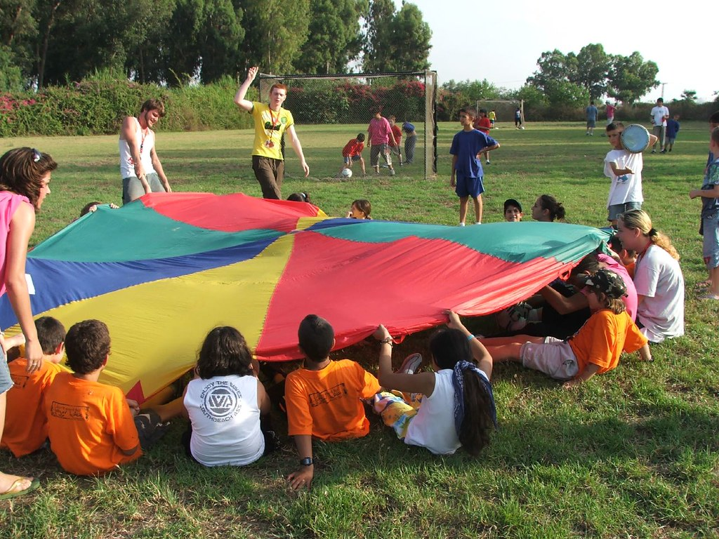
GAME DESIGN
Inspiration
What was the inspiration behind these graphics and “Story Line”?
Many games have cats and mice, however I myself have never seen an arcade version of it
Inspirations
Tom and Jerry (characters and show)
Speedy Gonzales(Looney Tunes)
Top Cat (Characters and Show)
Cat and mouse (Play Ground Game)

Slide 6


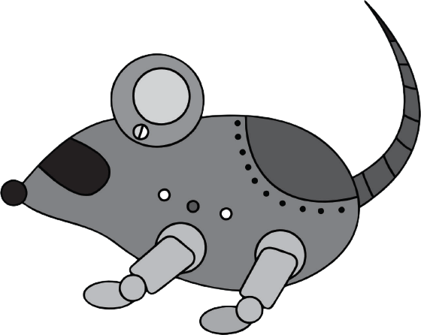


GAME DESIGN
Story Line
There is a mouse that LOVES to eat cheese BUT the neighborhood this poor mouse lives in, is infested with cats.
This little mouse is always starving and can never get its fill in food and so it looks for cheese to snack on.
This little mouse leaves his small little home, to find his favourite snack, Cheese!!!
However the mouse cannot escape the keen sight of a cat.

Slide 7
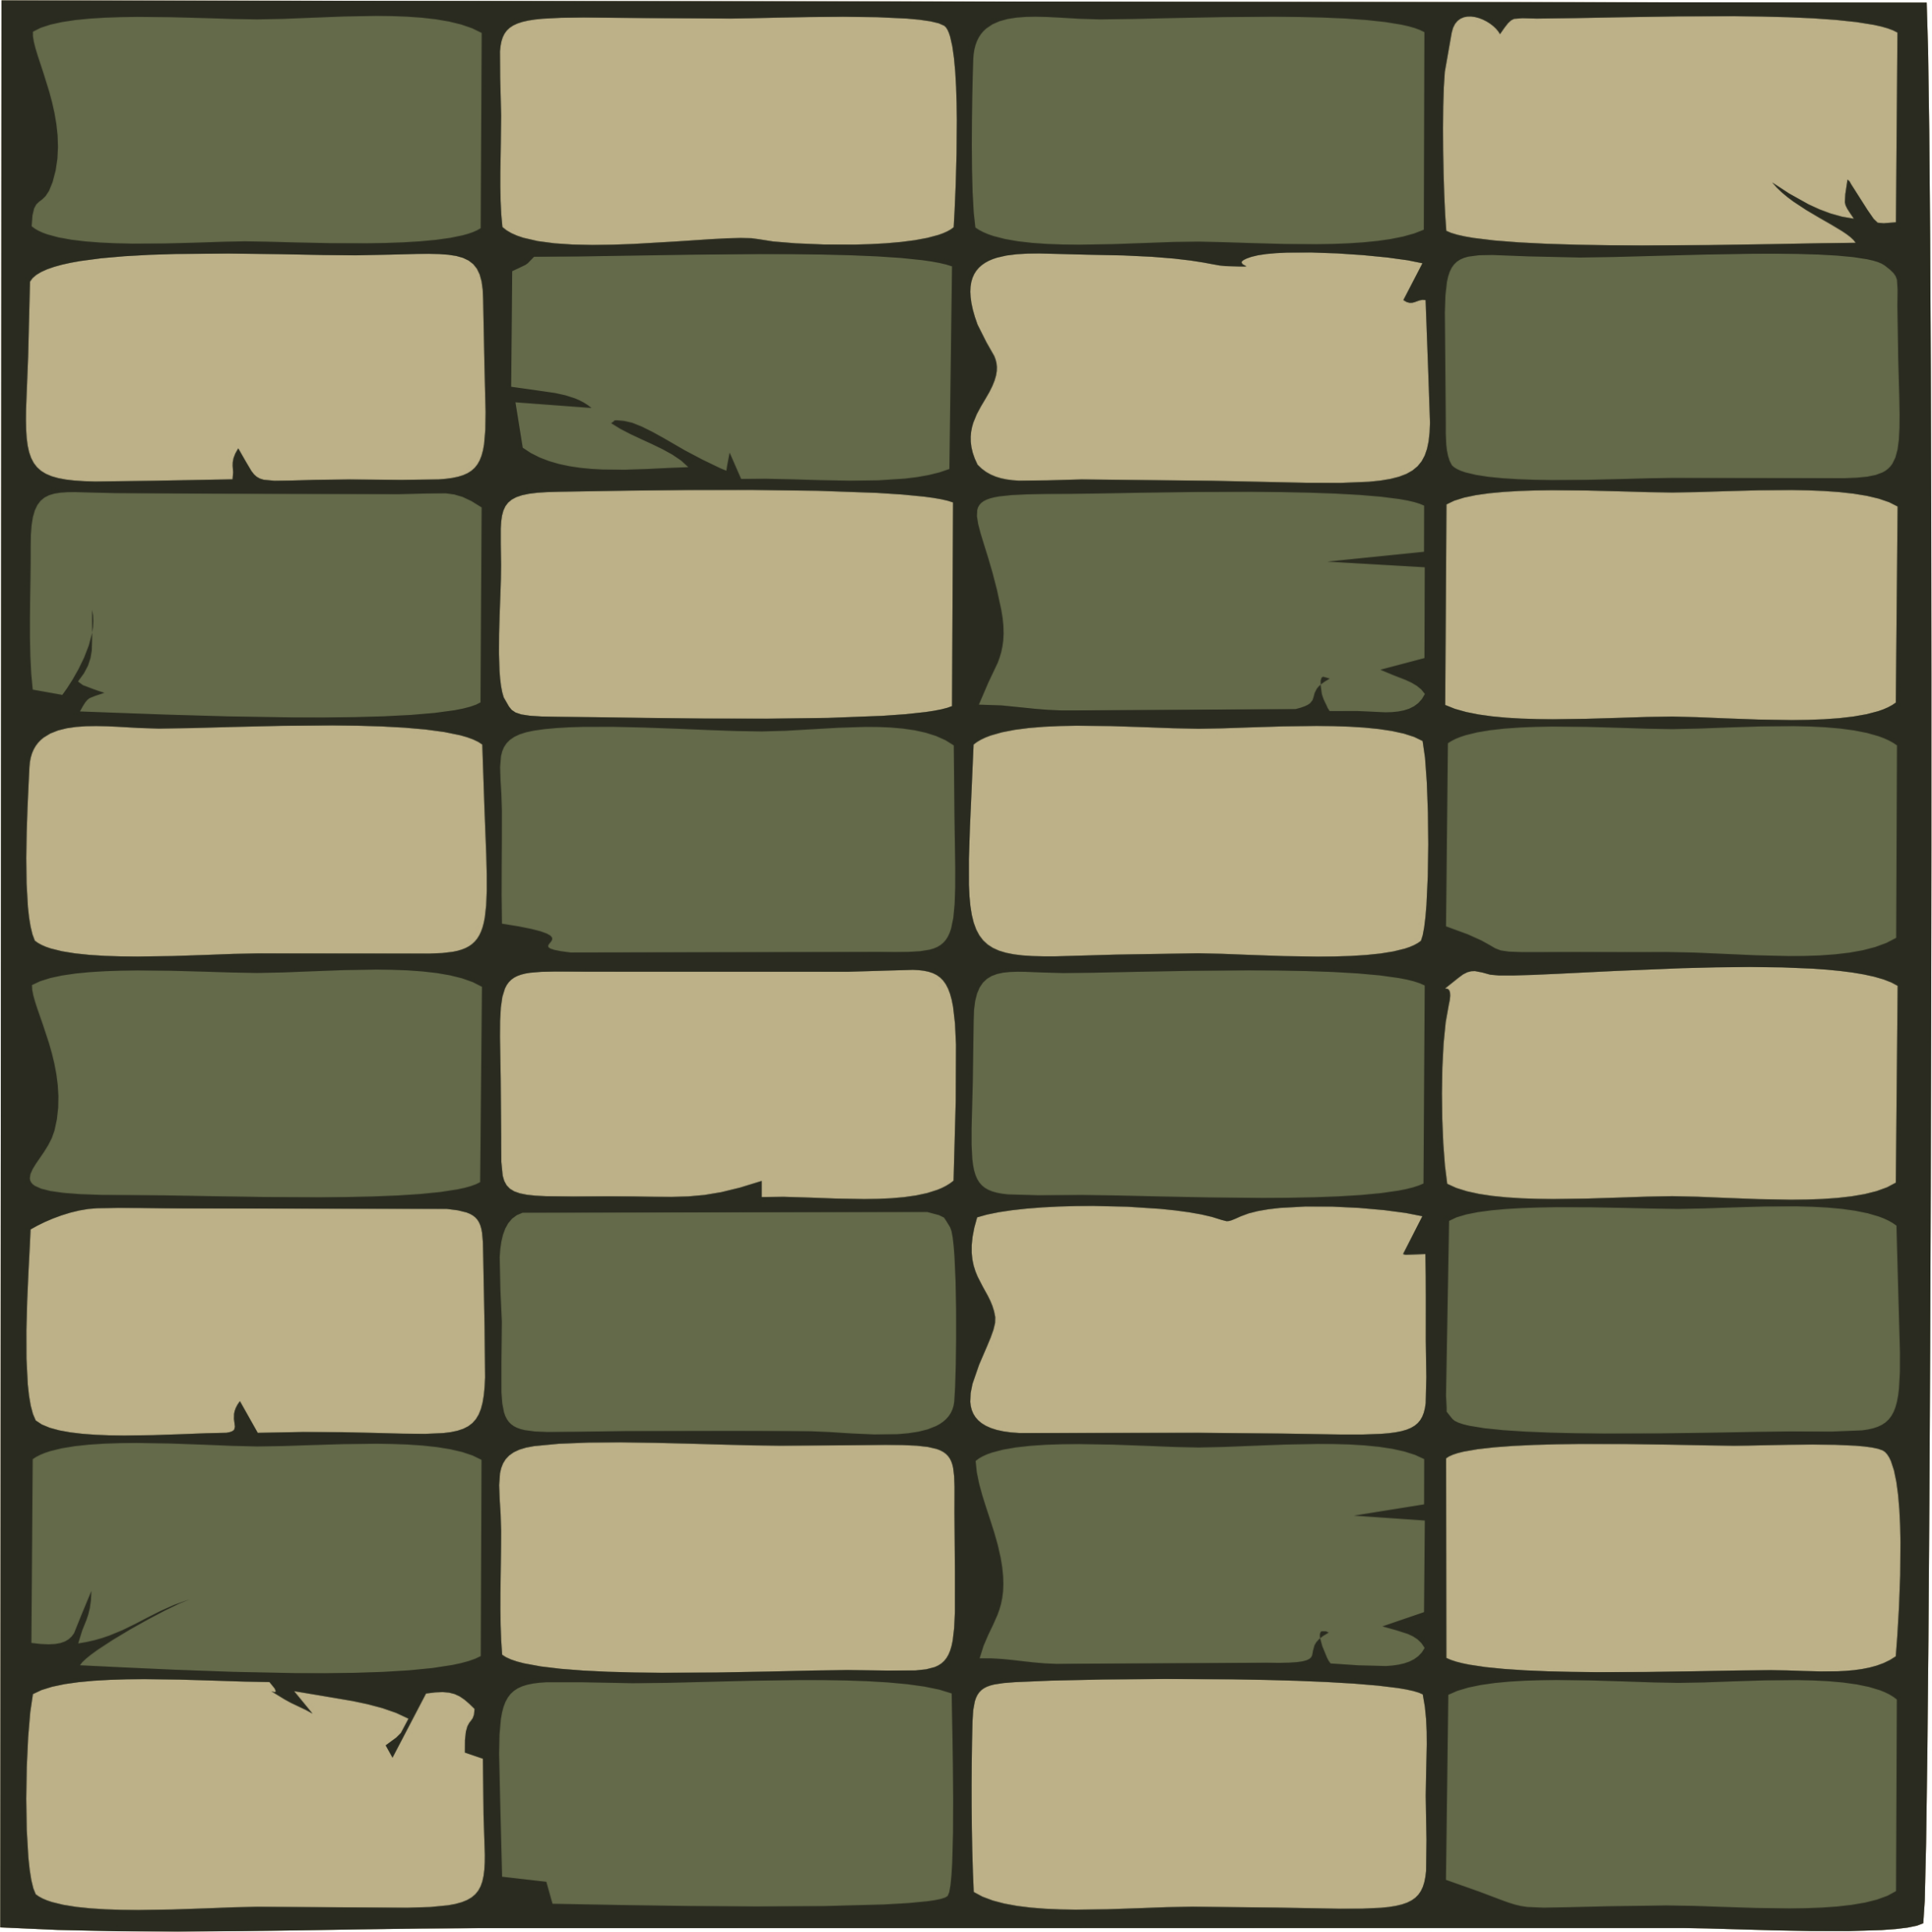
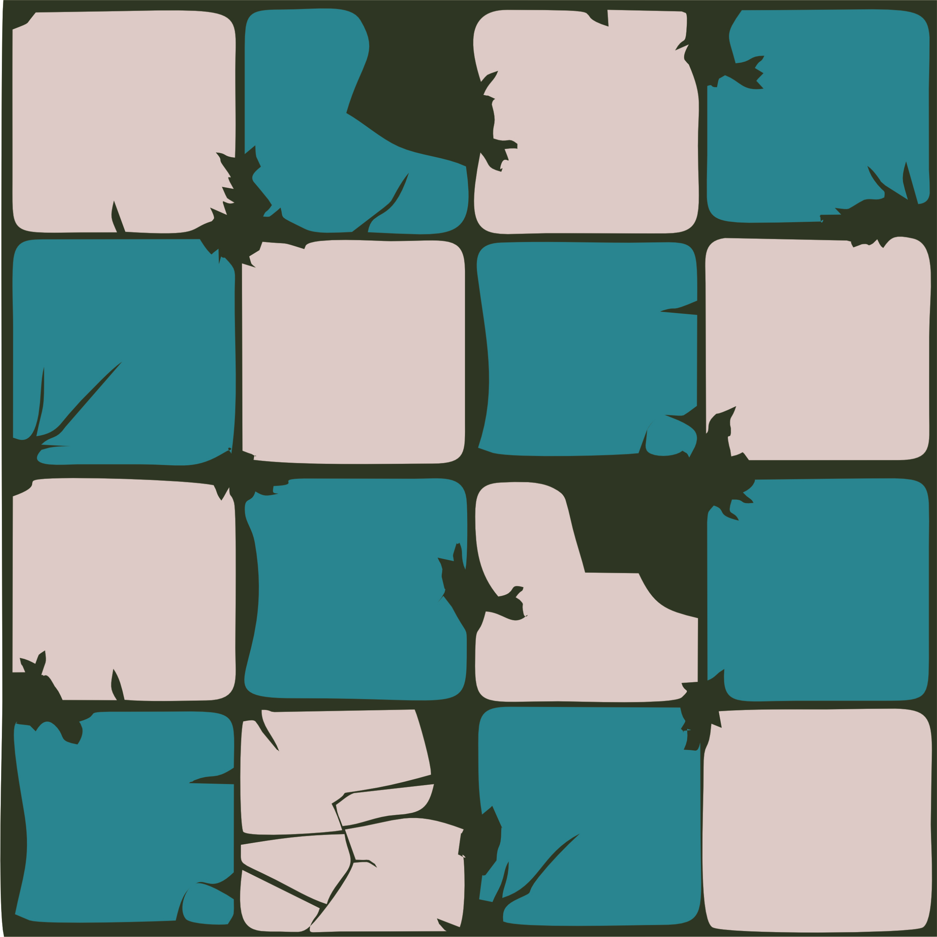
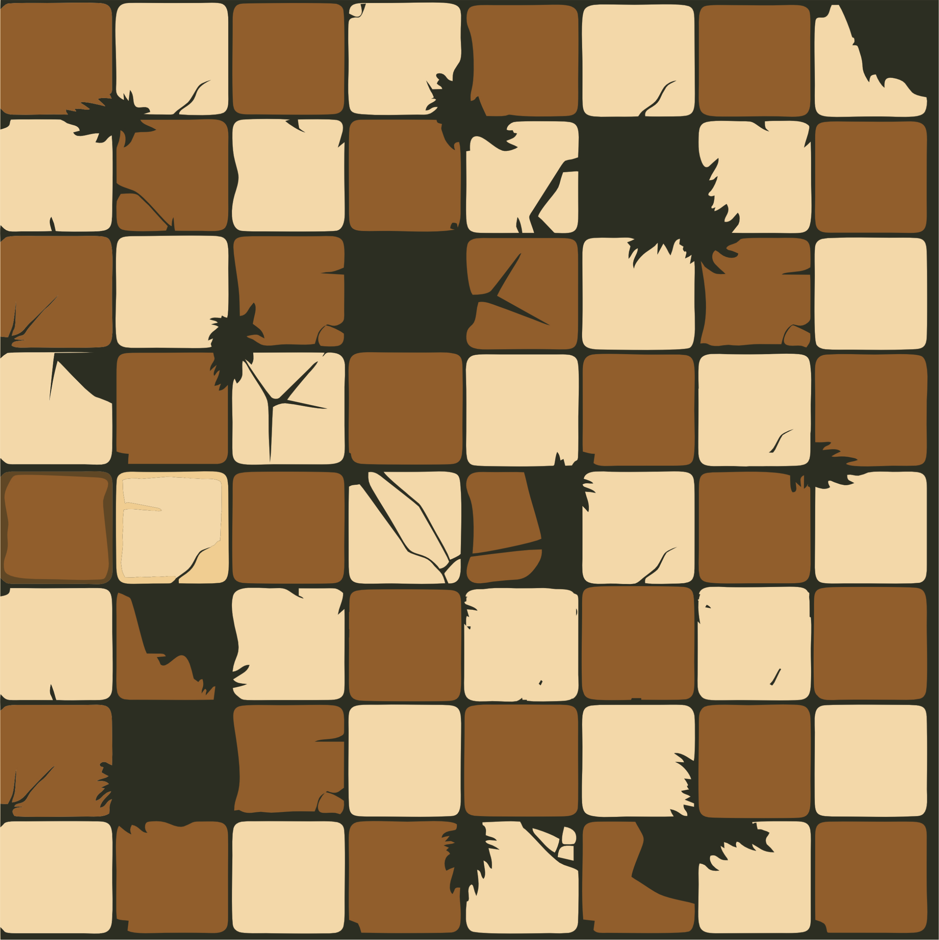
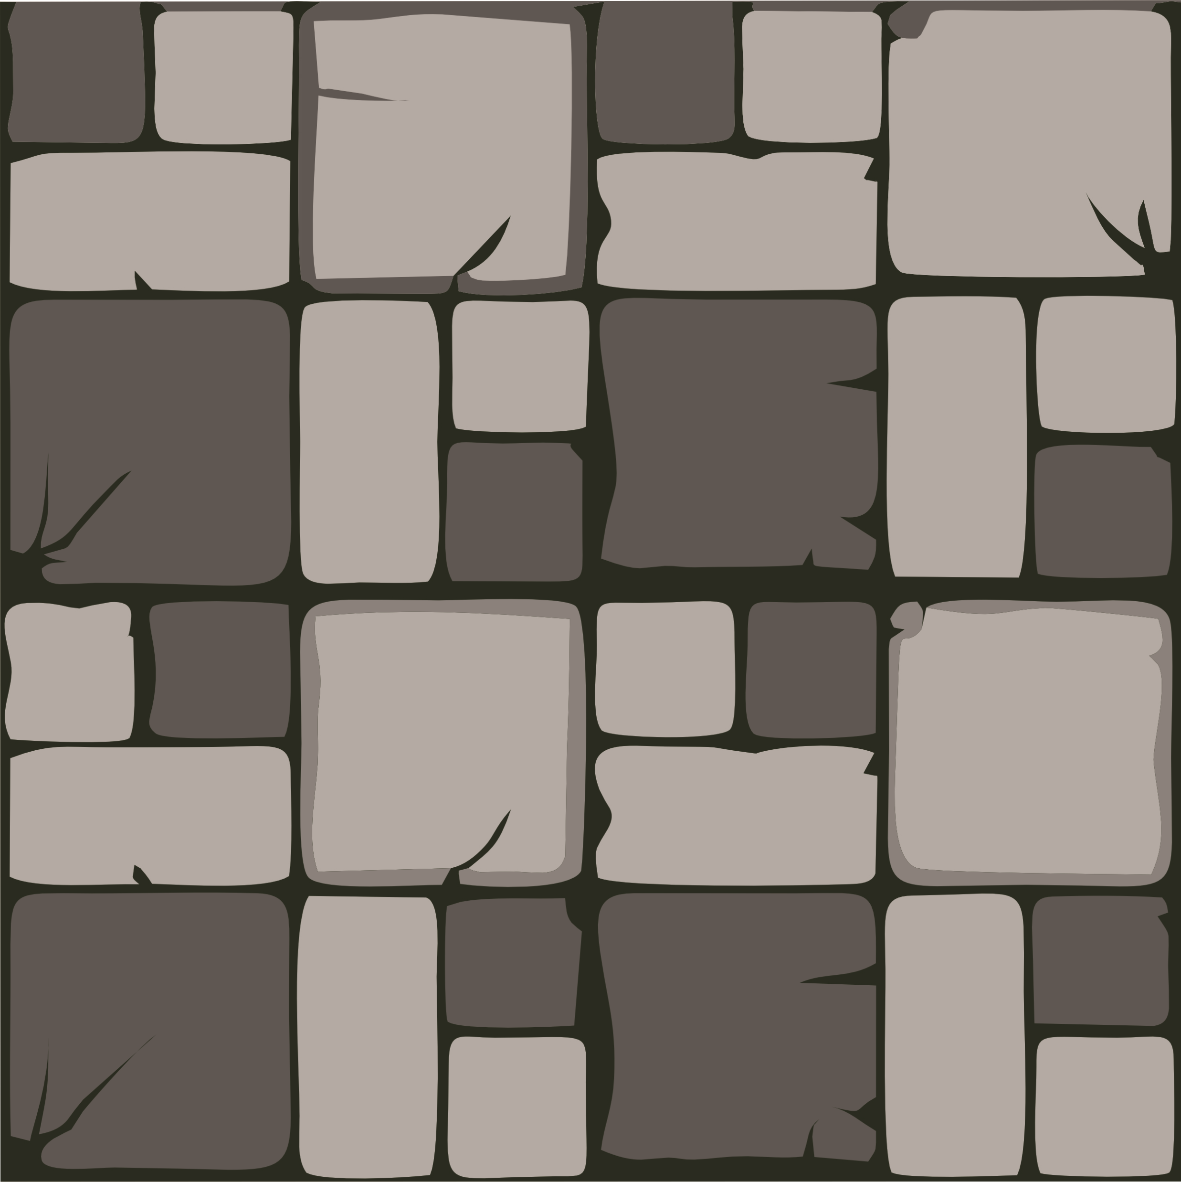
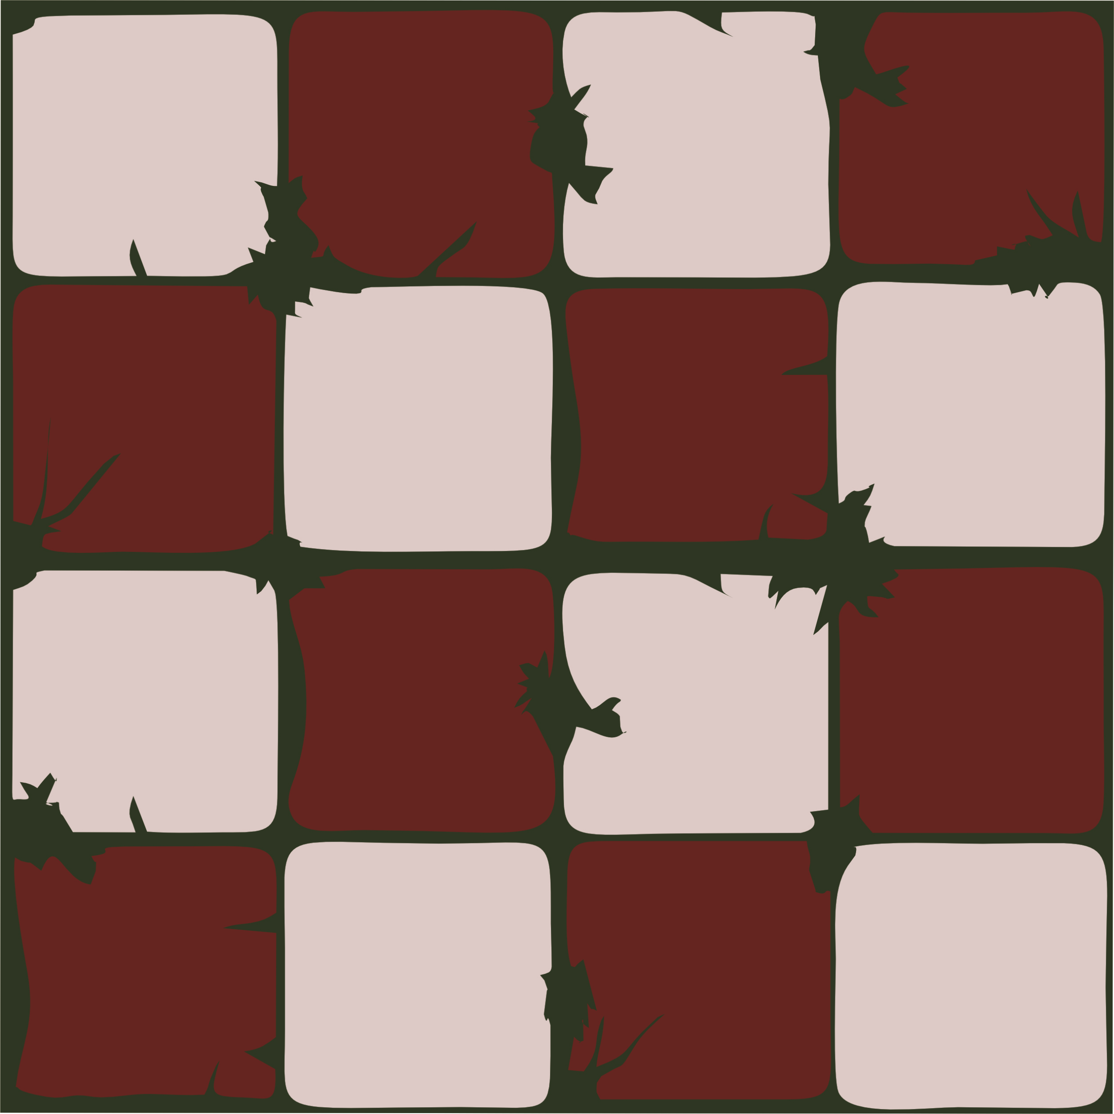
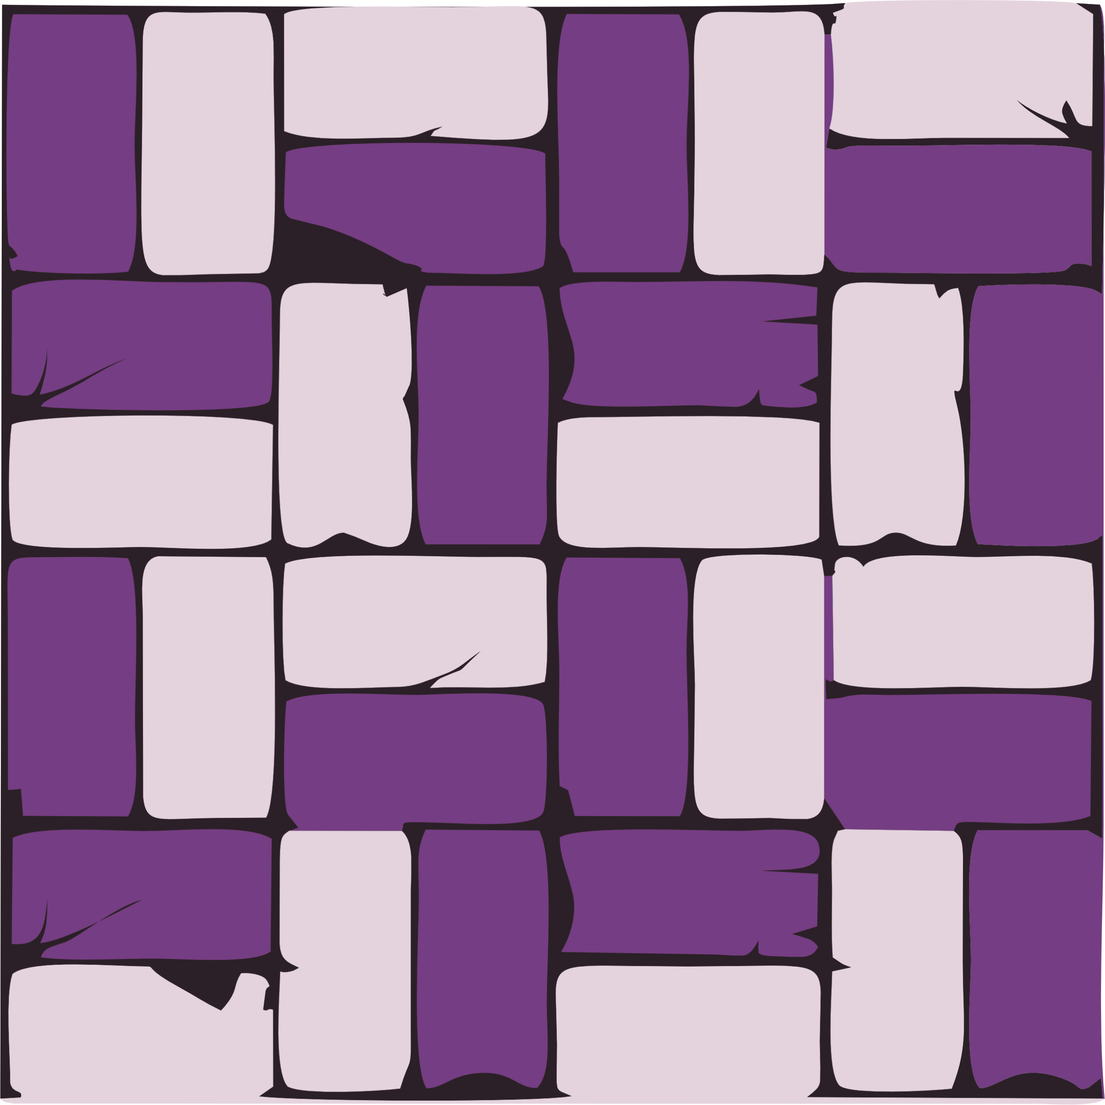
Destinations
GAME DESIGN
There are many destination within the game the mouse goes to, in search of it’s CHEESE.
All destination are run down and damaged
The mouse dashes from one location to another to escape the 20 cats chasing it

Slide 8
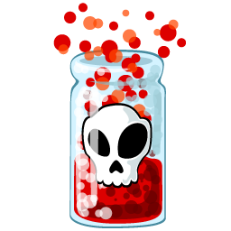

GAME DESIGN
Power Ups + Dangers
Every location has challengers especially for the mouse and ways to over come these challenges
Cheese – the mouses snack
Poisoned Cheese
Poison – dangerous for the mouse
Healing cheese
Health – protects the mouse from the poison

Slide 9
GOAL OF THE GAME
The person playing the game is playing as a mouse.
The player needs to collect cheese to increase the score
The score determines the background (destinations)
The goal as the developer while creating DASH was to ensure most things were random and certain values unknown to the player.
Unknown Values To Player
The backgrounds
The amount of lives available
Random Values
Speed of the mouse
Spawning of the power ups
Spawning of the dangers
Spawning of the Cheese

Slide 10


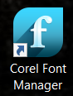

GRAPHICS
I used 4 image editors to create/edit the graphics
Paint
CorelDRAW
Font Editor
Befunky

Slide 11
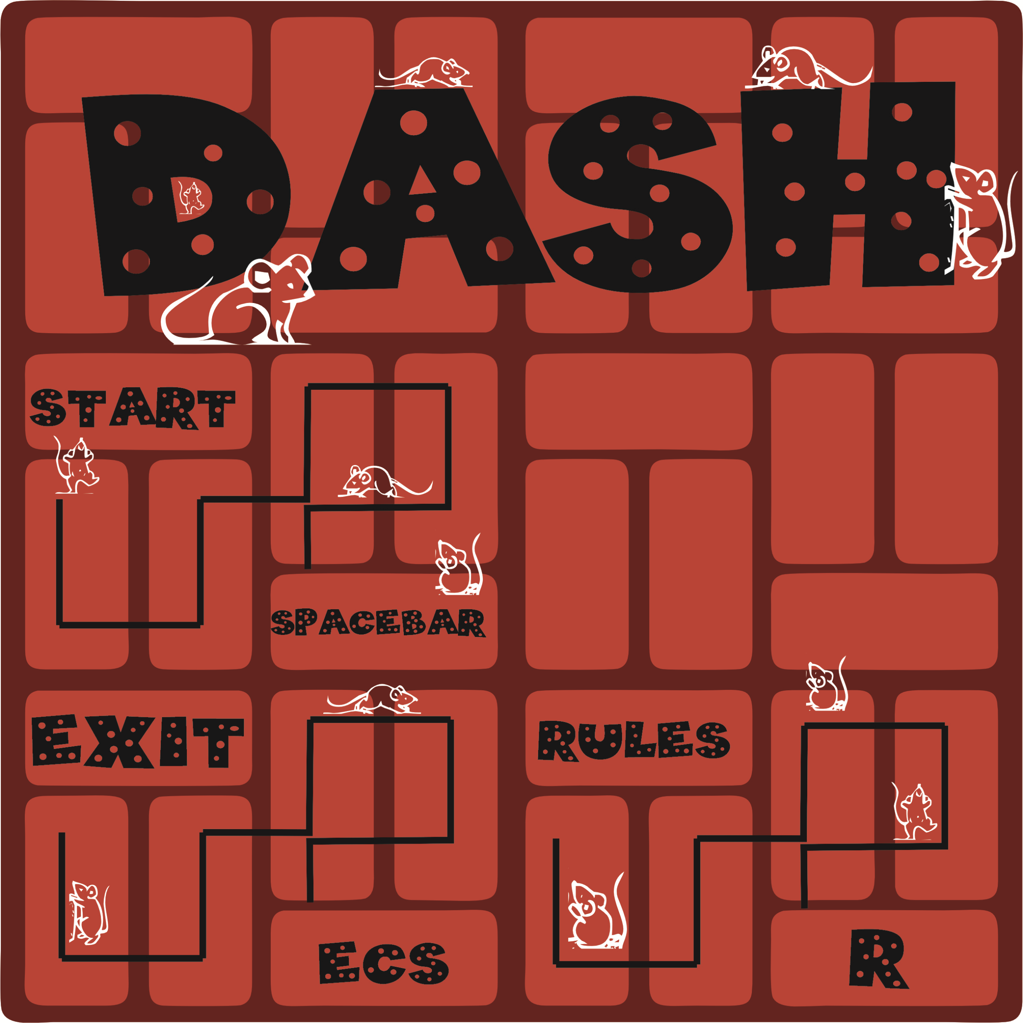
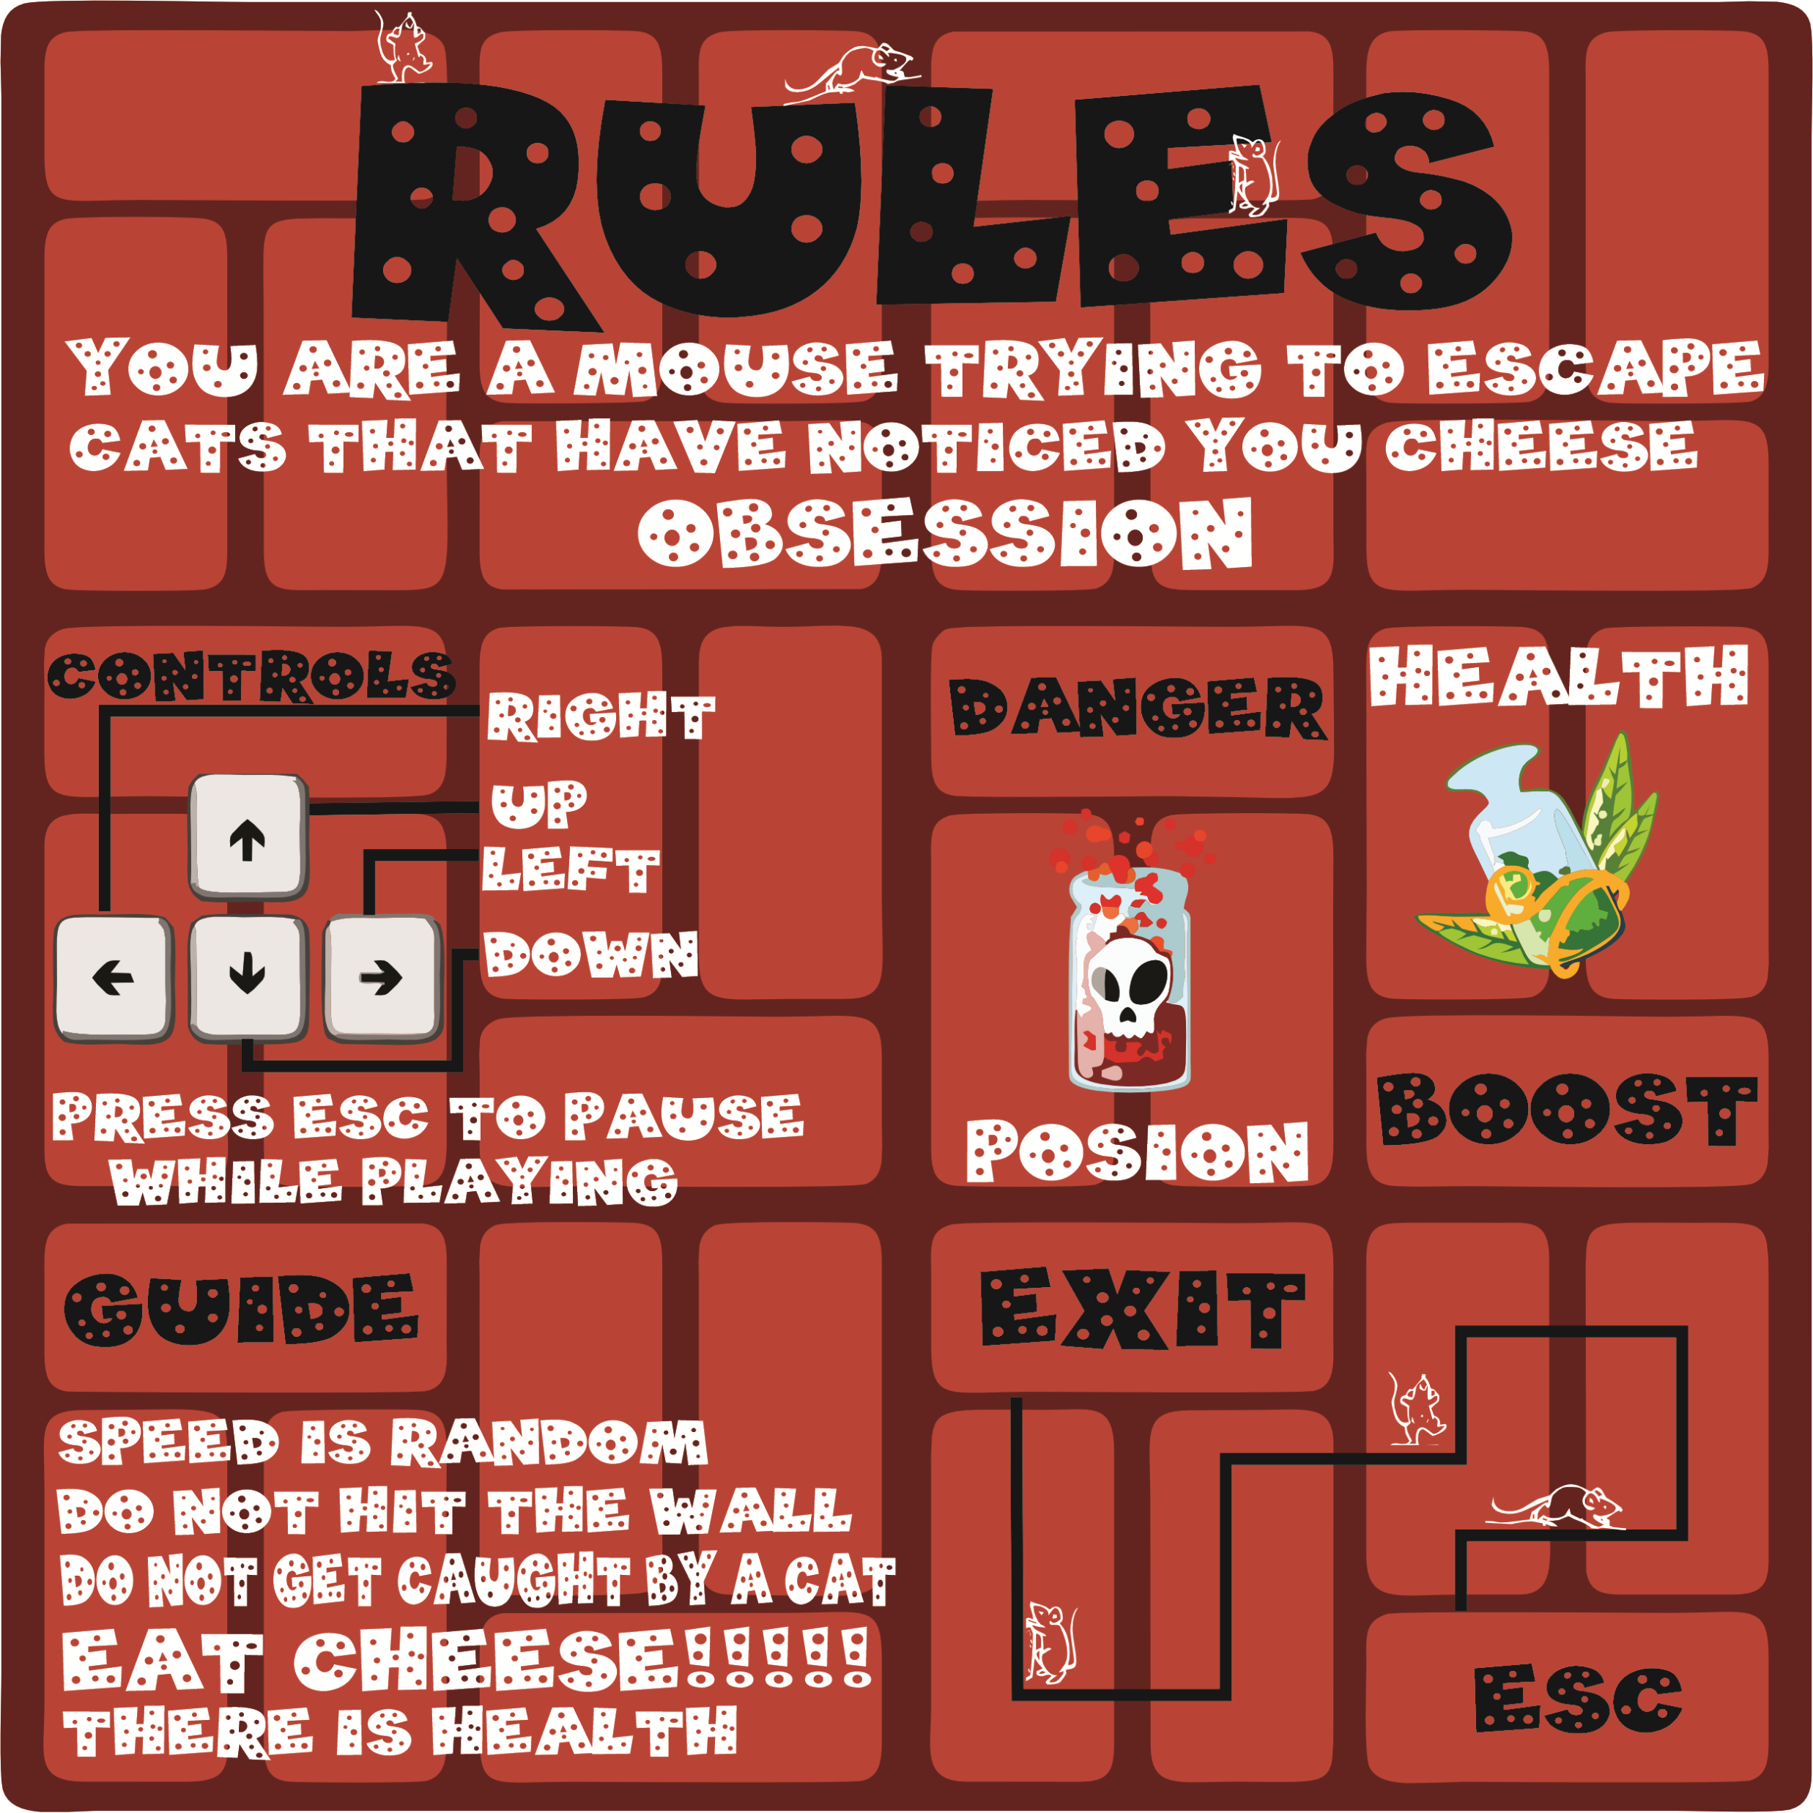
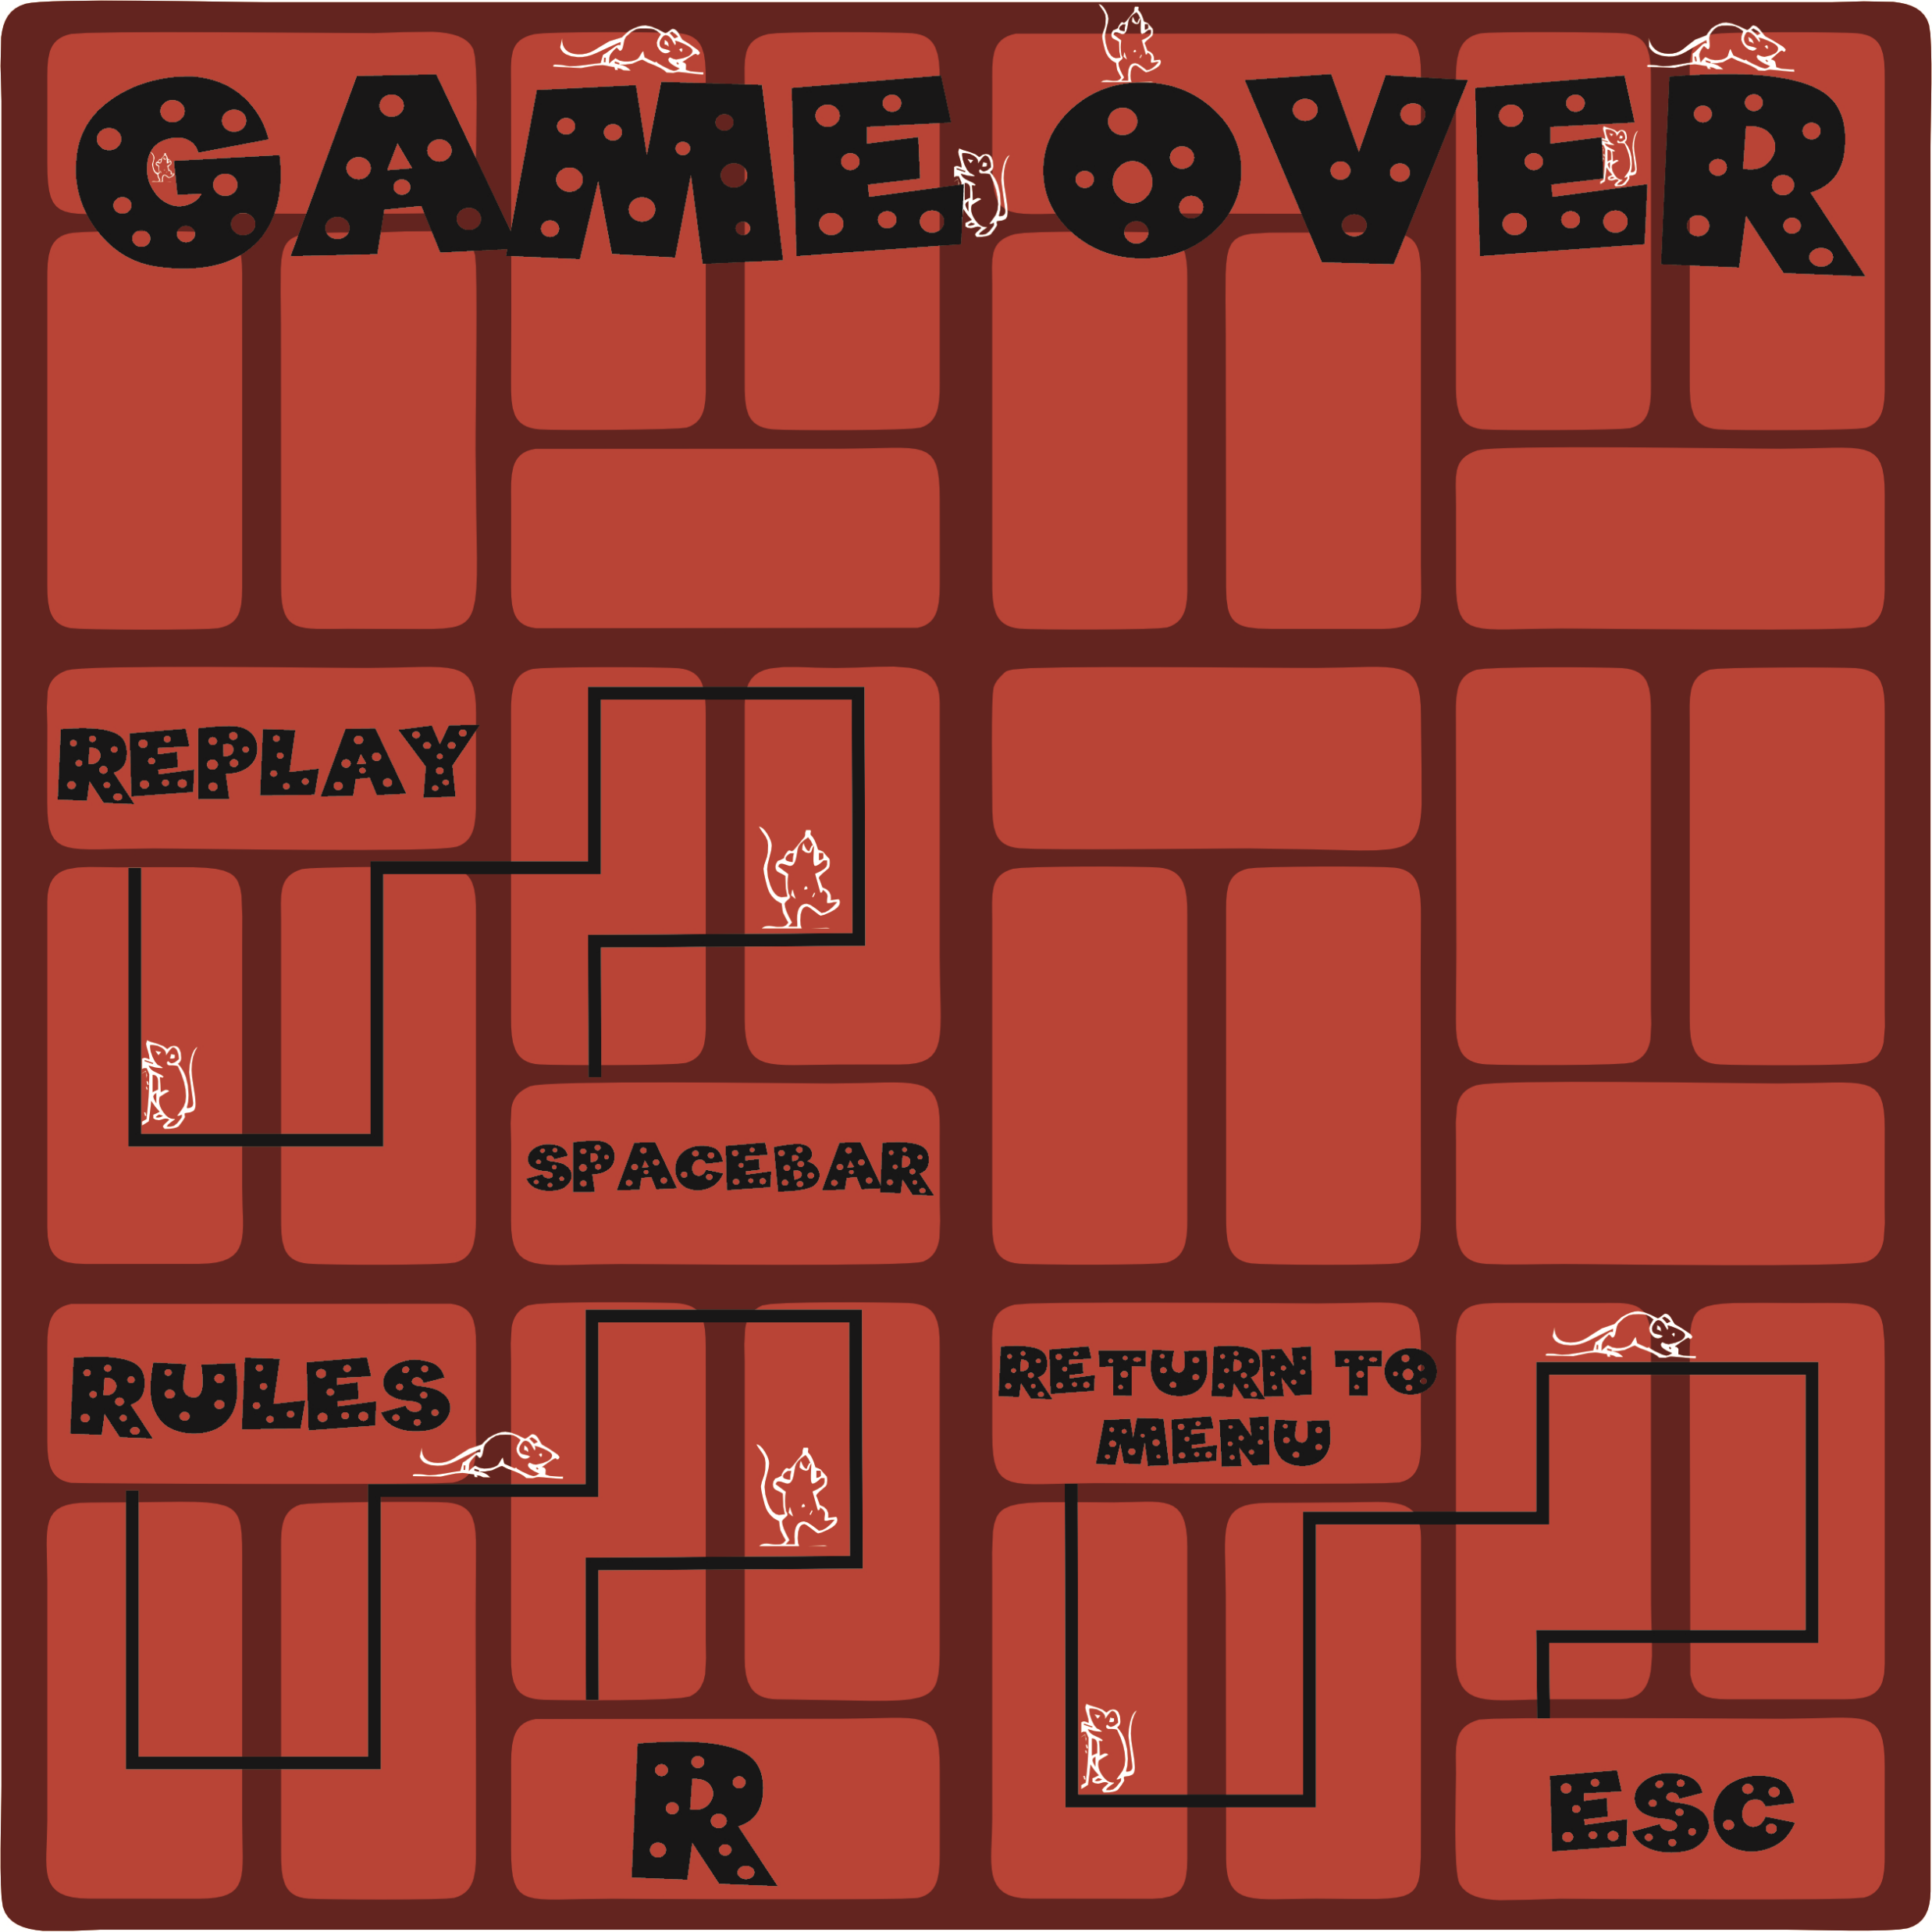
GRAPHICS
MENUS
START MENU
Rules Menu
Game over Menu

Slide 12
The colour of some of the some backgrounds conflicts with the colour of the Cats, the Mouse or the Health/Poison
Arcade look to the game

Slide 13

DIFFICULTY
Random values
Speed of the mouse and cats are random
Unknown type of power up or danger
Uncertain values
Lives
Position of the power ups or values
Graphics
Conflicting colours

Slide 14
CHALLENGES
First year programming
Creating the graphics
The closest to programming was HTML.
It was challenging creating all the features I wanted that the SNAKE doesn’t have.
Never used any image editing software.
Time consuming
Thought Process
Time consumption
Have to many Ideas and haven’t learnt the skills to implement
Learning the require skills
Other projects and assignments

Slide 15
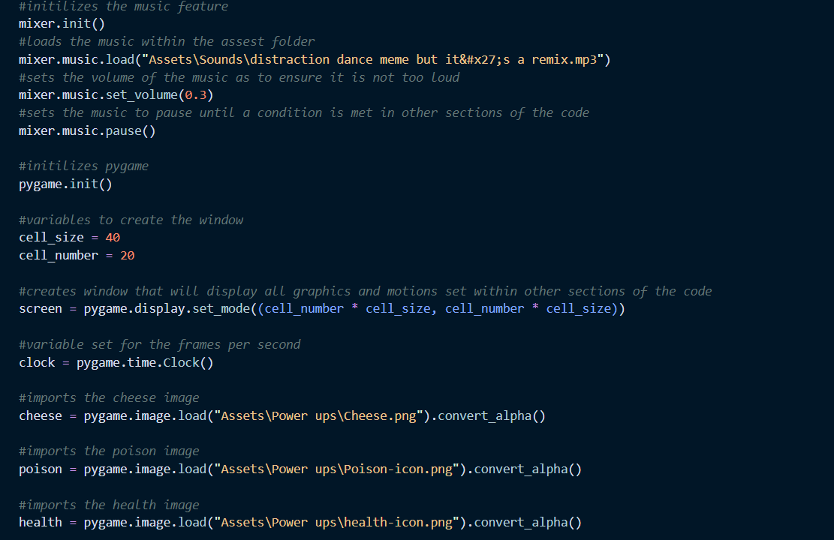
Visual Studio Code
Visual Studio Code (VS Code) is a source editor that helps developers to easily debug and fix errors.
VS Code was the platform used to develop the game DASH
The code to this game can be view in VS Code

Slide 16

SOUND
A sound plays when the mouse eats the cheese, poison or health
Cheese
Health
Poison
Music is playable once the player starts the game

Slide 17

GAME
A VIDEO AS AN EXAMPLE OF WHAT THE GAME LOOKS LIKE

Slide 18

Q & A
If you are unsure of any aspect with in this presentation please do no hesitate to ask.

Slide 19
THE END
Thank you for your time

